Slide 1
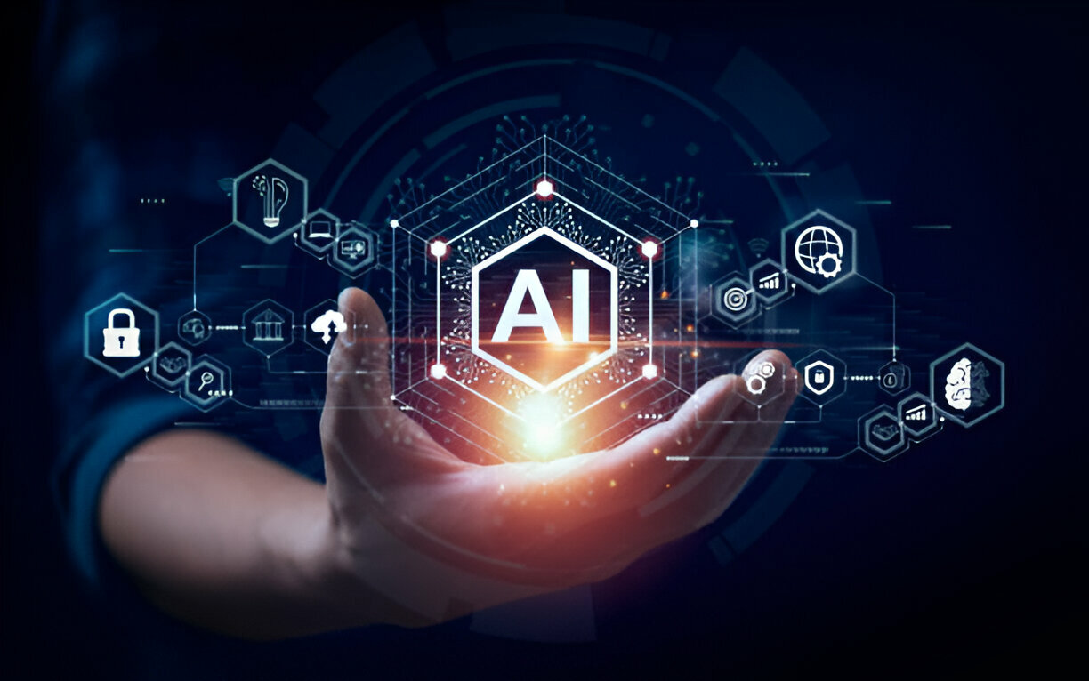

ARTIFICIAL INTELLIGENCE

Slide 2
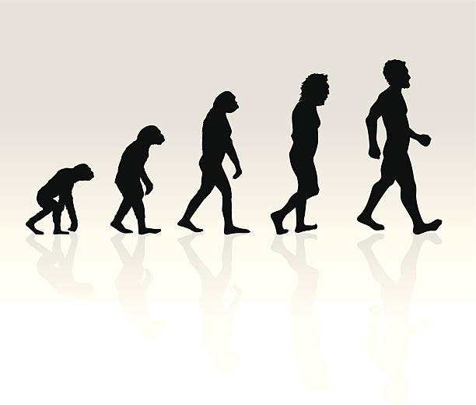

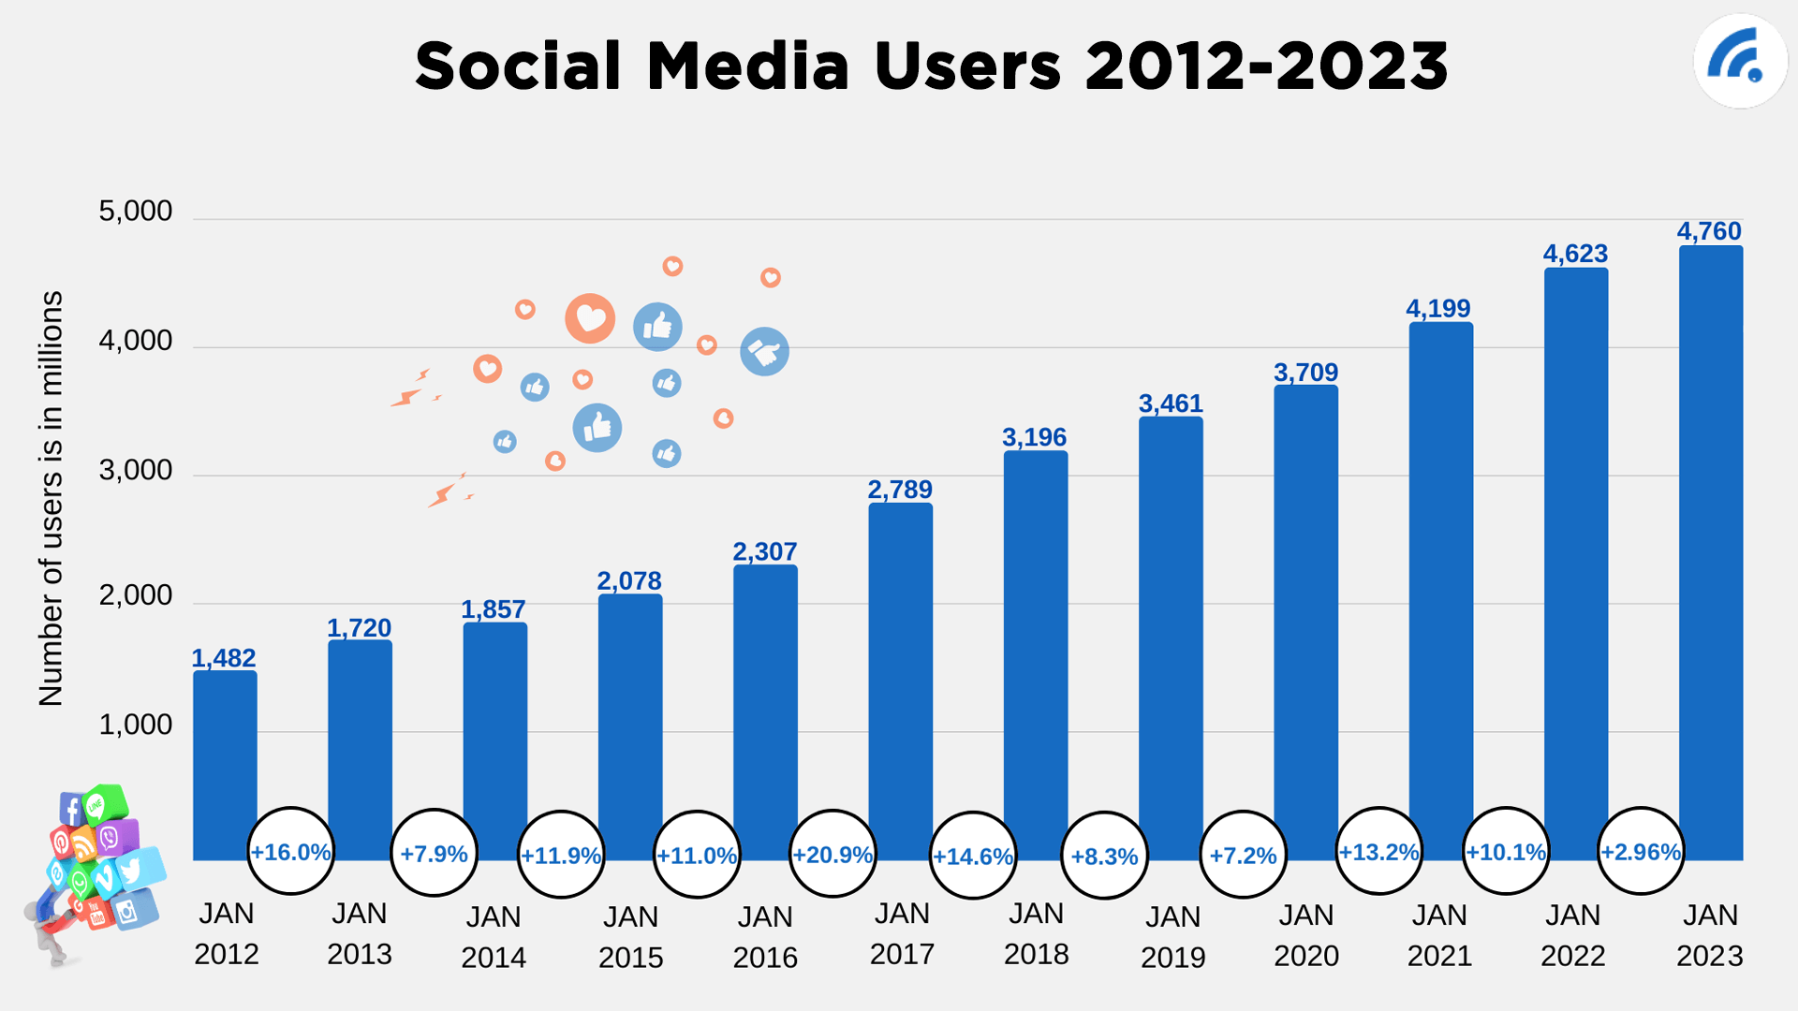

Evolution of human being image
last 20 years data generated show all social media

Slide 3
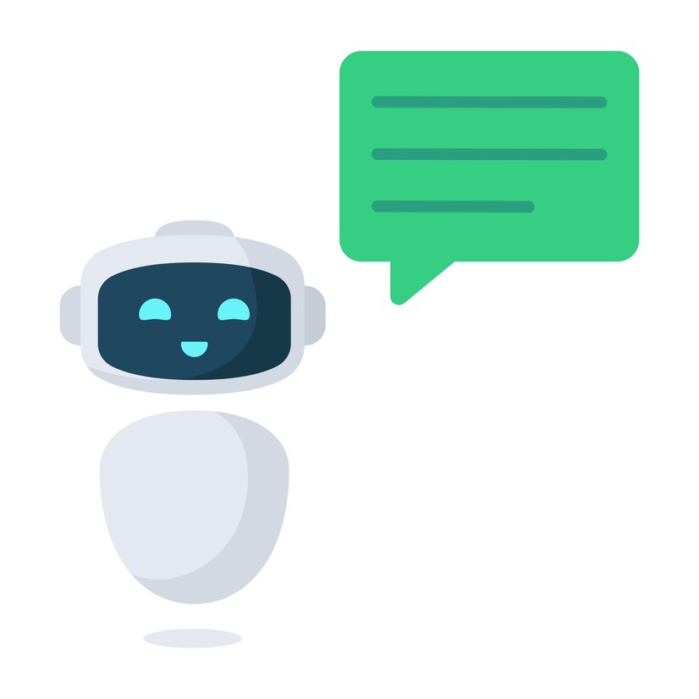
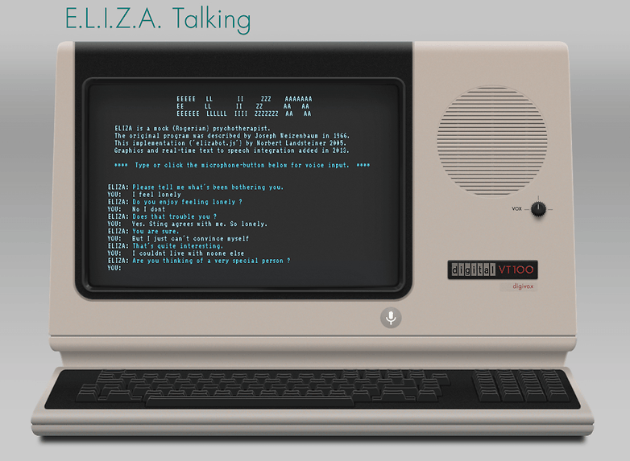
Early Language Models 1950 to 1980
ELIZA (1966)
Computers used rules written by humans to reply to messages.

Slide 4
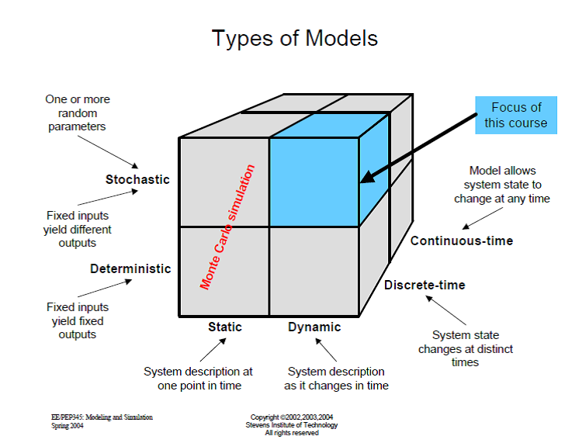
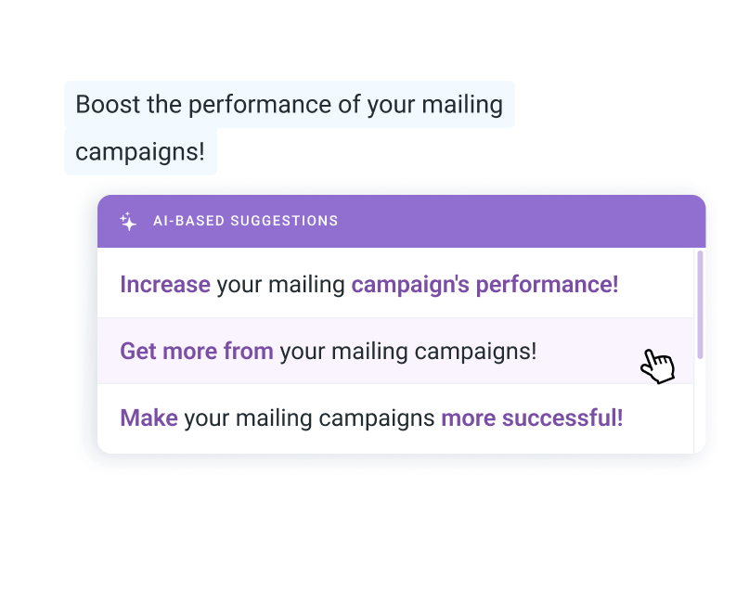
Mathematical Models (1990s–2000s)
Example: Your phone’s autocorrect – if you type
"I am going to the...", it suggests "market" or "school" based on probability

Slide 5
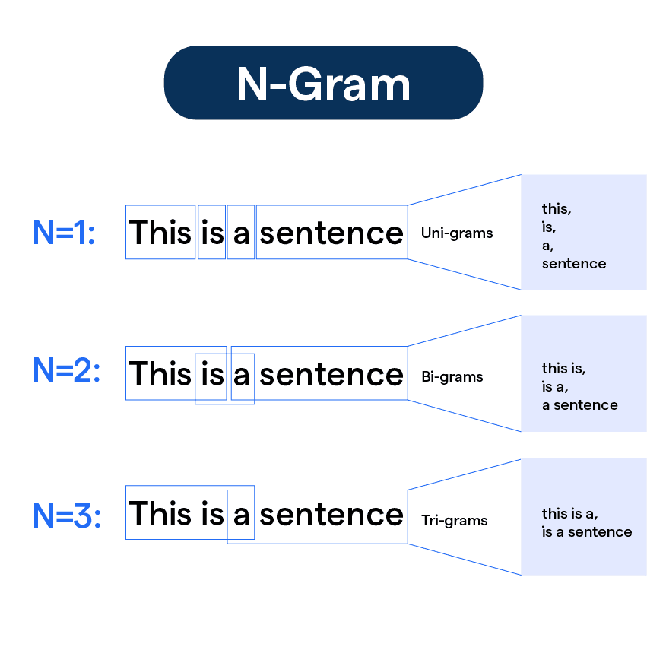
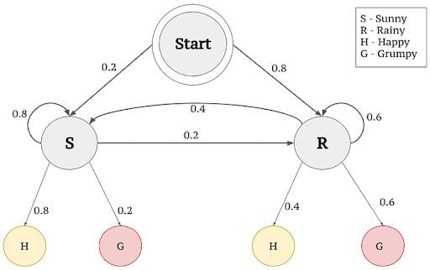
Statistical Language Models (1990s–2000s)
N-gram Models: Used probabilities to predict the next word based on a sequence (e.g., bigrams, trigrams).
Hidden Markov Models (HMMs): A probabilistic model used for speech recognition and part-of-speech tagging.

Slide 6
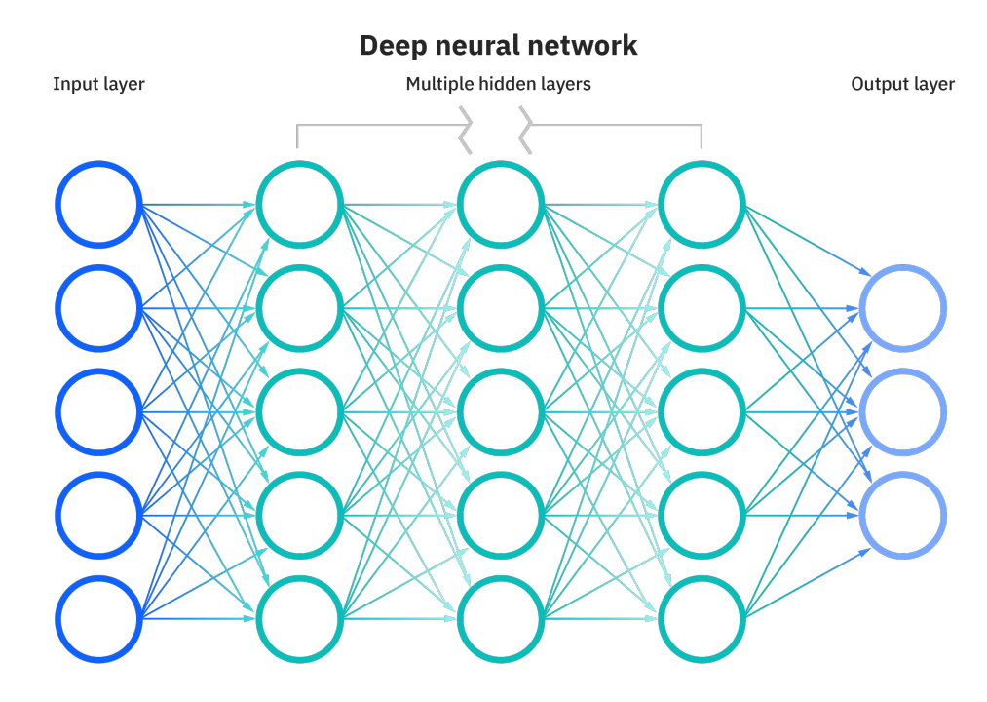
The Big Change – Neural Networks & AI Learning Like Humans (2000s–2010s)
If a baby hears “Apple is a fruit” many times, they remember that apples are fruits.

Slide 7
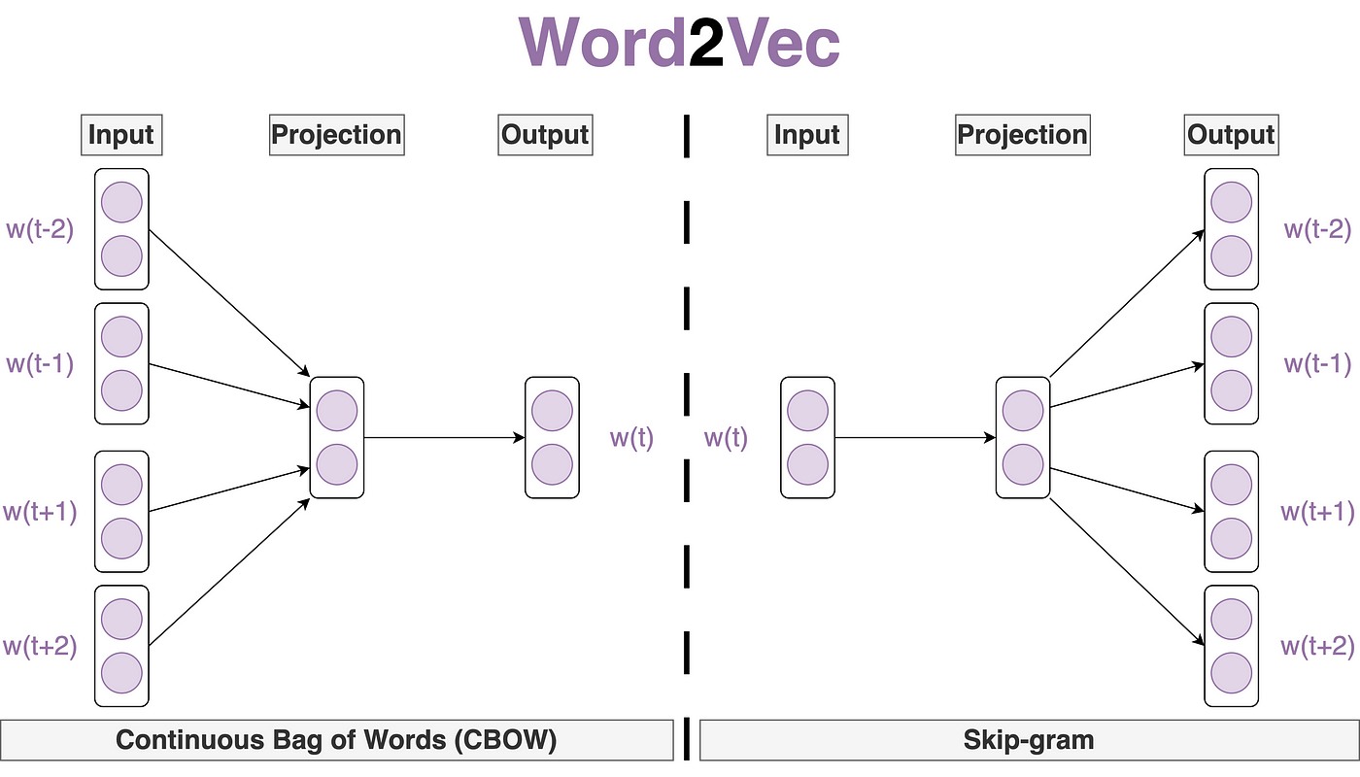
Major Breakthroughs (2000s–2010s)
Example: AI learned that:
King – Man + Woman = Queen 👑
Paris – France + Germany = Berlin 🏙
Word2Vec represented words as vectors (numbers), allowing AI to recognize relationships
Before Word2Vec, AI treated words like separate items with no connections.
Word2Vec (2013) – Understanding Word Relationships

Slide 8
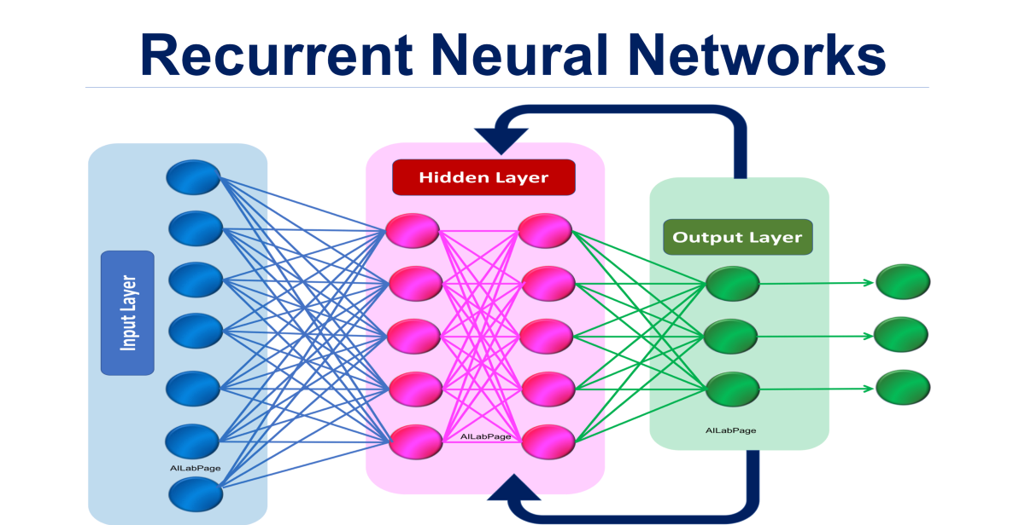
2. Recurrent Neural Networks (RNNs) (2014-2015) – Understanding Sentences
Unlike previous models, RNNs could read a sentence word by word and remember what came before.
Used for: Chatbots Machine Translation (Google Translate) Speech Recognition (Siri, Alexa)

Slide 9
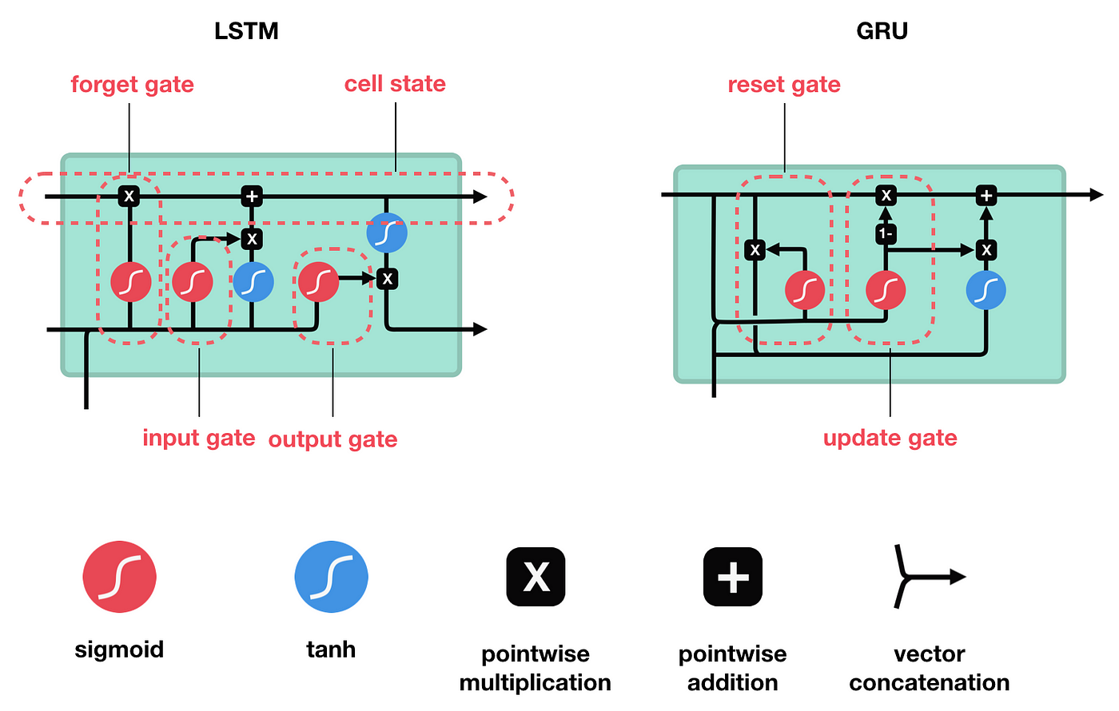
3. Long Short-Term Memory (LSTM) & Gated Recurrent Units (GRUs) (2015-2017) – Improving Memory
RNNs struggled with long texts, so LSTMs & GRUs were invented to remember longer sentences.
Used for:
Better Chatbots 💬 Improved Speech Recognition 🗣
More Accurate Translations 🔄

Slide 10
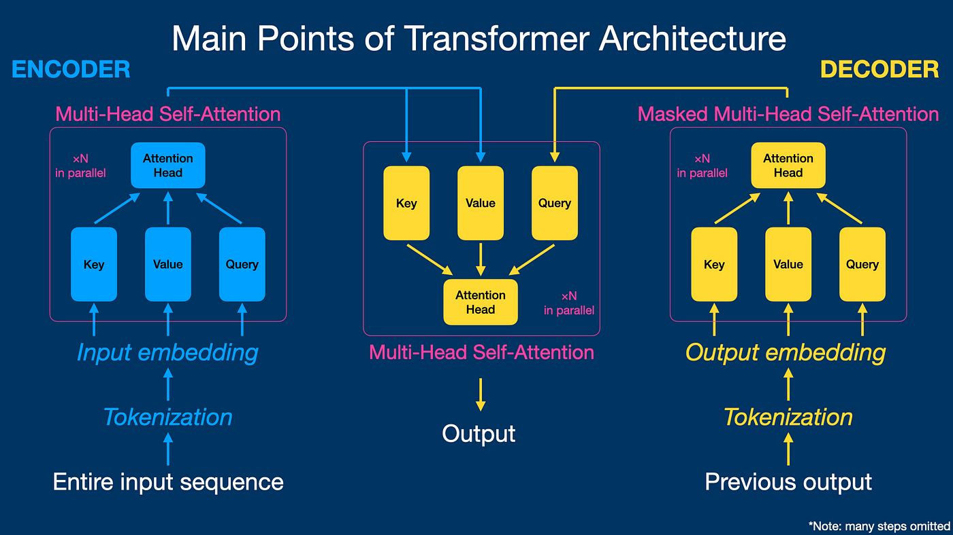
4. The Big Game-Changer – Transformers (2017)
What is a Transformer?
That’s when Transformers were introduced in 2017 by Google researchers in a paper called "Attention is All You Need."
"I saw a bat flying in the sky." → It must be an animal.
"I saw a bat in the cricket field." → It must be a cricket bat.
Transformers = AI can now "think" smarter by looking at the full sentence, not just one word at a time!

Slide 11


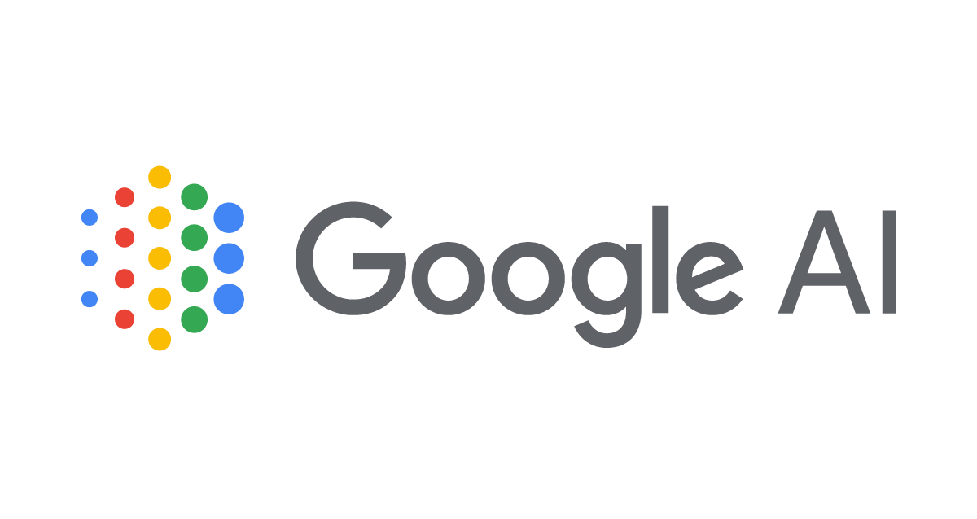

1. Large Language Models (LLMs): Focus on understanding and generating human language
GPT-4 (OpenAI): Known for strong performance in text generation, translation, and code generation.
Llama 2 (Meta): Open-source LLM, widely used for research and development.
Gemini (Google): Multimodal, handling text, images, and other modalities.
LaMDA (Google): Designed for dialogue and conversational AI.

